Slide 1
Iteration for Nonlinear Systems

Slide 2
Three important methods to solve the problem
1---Fixed-Point Iteration
2---Seidel Iteration
3---Newton’s Method for Nonlinear Systems

Slide 3
Background:
We desire to have a method for finding a solution for the system of nonlinear equations
How to do it?
Do you remember fixed-point iteration to solve f(x)=0 in chapter 1?

Slide 4


A fixed point for the system of two equations
is a point (p,q) such that .
Similarly, in three dimensions a fixed point for the system of three equations
is a point
such that

Slide 5
The fixed-point iteration is
Similarly, for a system of three equations, fixed point iteration is

Slide 6

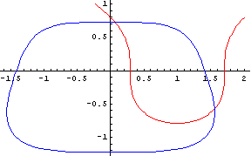
Example. Use fixed point iteration to find a solution to the nonlinear system
From the graph, we can find a numerical approximation to the solution near (0.1,.07) and (1.5,-0.5)

Slide 7
Start with an initial point (po,qo),then
p1=(2po^2+2qo^3+1)/4
q1=(-po^4-qo^4+8qo+4)/12
Set (po,qo)=(0.1,0.7)

Slide 8
Now we go on to find the solution near (1.5,-0.5)
Set
Why this happen?

Slide 9


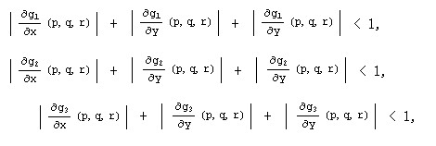
Fixed-Point Iteration Theorem
Case (i) Two dimensions: if (po,qo) is sufficiently close to (p,q) and if
Then the iteration converges to the fixed point(p,q)
Case (ii) Three dimensions
If these conditions are not met, the iteration might diverge, which is usually the case

Slide 10
Seidel iteration
p_{k+1}=g1(pk , qk) and q_{k+1}=g2(pk+1,qk)
and
p_{k+1}=g1(pk,qk,rk)
q_{k+1}=g2(p_{k+1,}qk,rk)
r_{k+1}=g3(p_{k+1},q_{k+1},rk)
Also have some limits

Slide 11


Newton’s Method
a generalization of Newton’s method for the one-variable case:
pk+1=pk-f(pk)/f’(pk)
(pk+1=pk+△p)
consider the system:
considered a transformation from the xy-plane to the uv-plane,and see how it change

Slide 12



substitute the changes
for
we get
Also , it can be written as
Suppose we are trying to find the solution (p,q) and we start iteration at the nearby point (po,qo) ,so
Notice: f1(p,q)=0 f2(p,q)=0

Slide 13



So , it becomes
or
(approximate)
Now , we can solve
The next approximation
Show the Newton’s Method step by step
Step 1
Step 2

Slide 14
Step 3
Step 4
Next , we will see an example

Slide 15



Use Newton's method to solve the nonlinear system
F(x,y)=
Start with the value (po,qo)=(0.1,0.7)

Slide 16
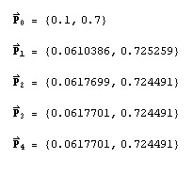
Use the equation
to get △p
If we use Newton’s method , what will happen when computing the other solution near (1.5,-0.5)

Slide 17
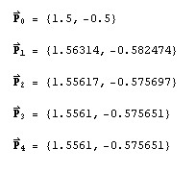
Newton’s method solve this problem efficiently , but in a higher dimensions it is necessary to use some methods for solving linear systems.

Slide 18
That is all ! Thank you !!
参考：Numerical Methods Using MATLAB (fourth edition)
Google , Bing , Baidu

